Slide 1
E-retail factors for customer activation and retention: A case study from Indian e-commerce customers

Slide 2
Introduction
Over the years with advancement of technology, the demand for online shopping and e-commerce websites have increased significantly. In the Indian online retail industry, some of the major players are Amazon, Myntra, Flipkart, Snapdeal and Paytm. They are strongly competing with each other and implementing effective strategies to enhance customer acquisition. The project will explore the insights drawn from the data collected from the customers.

Slide 3
Problem statement
E-retail factors for customer activation and retention: A case study from Indian e-commerce customers
Customer satisfaction has emerged as one of the most important factors that guarantee the success of online store; it has been posited as a key stimulant of purchase, repurchase intentions and customer loyalty. A comprehensive review of the literature, theories and models have been carried out to propose the models for customer activation and customer retention. Five major factors that contributed to the success of an e-commerce store have been identified as: service quality, system quality, information quality, trust and net benefit. The research furthermore investigated the factors that influence the online customers repeat purchase intention. The combination of both utilitarian value and hedonistic values are needed to affect the repeat purchase intention (loyalty) positively. The data is collected from the Indian online shoppers. Results indicate the e-retail success factors, which are very much critical for customer satisfaction.

Slide 4
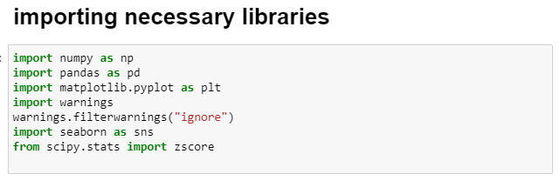
Step 1: importing the libraries

Slide 5
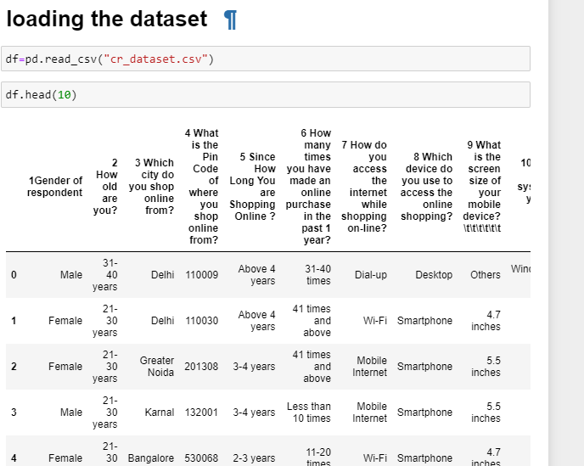
step 2: loading the dataset

Slide 6
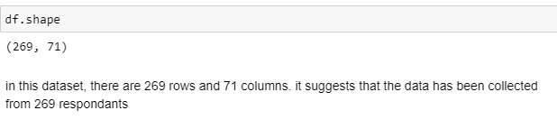
step 3: Checking shape of the dataset

Slide 7
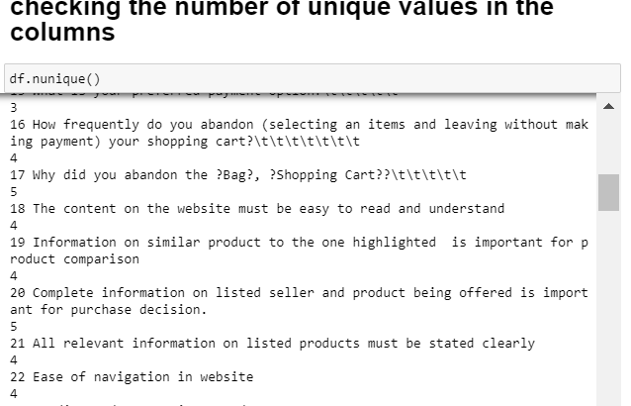
step 5: Checking number of unique values in the columns

Slide 8
Step 7: EDA and visualisation

Slide 9
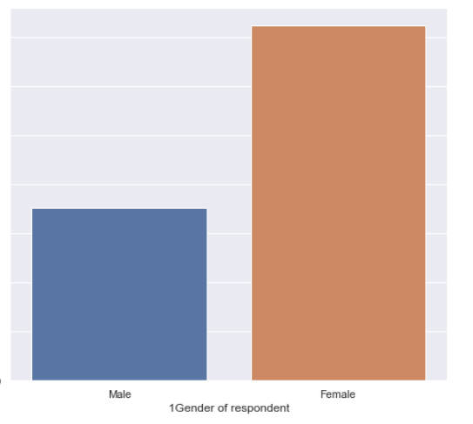
Number of female respondents is more than male counterparts

Slide 10
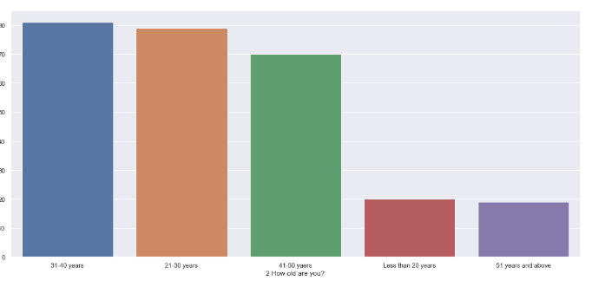
1.majority of the participants are in the age group of 31-40 years, and minimum participants are above age 51 years, who shop shop e-commerce. 2. people of age below 20years also shop less from e-commerce or online stores

Slide 11
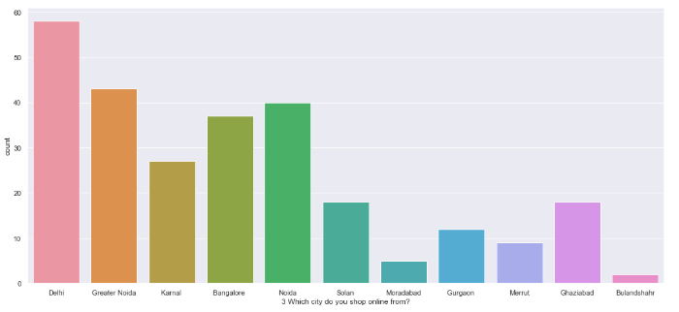
maximum e-commerce shoppers are from Delhi and the minimum shoppers are from Bulandshahr, it can also be abbreviated that in the regions of Moradabad, Merut, Bulandshahr people are reluctant to use online store

Slide 12
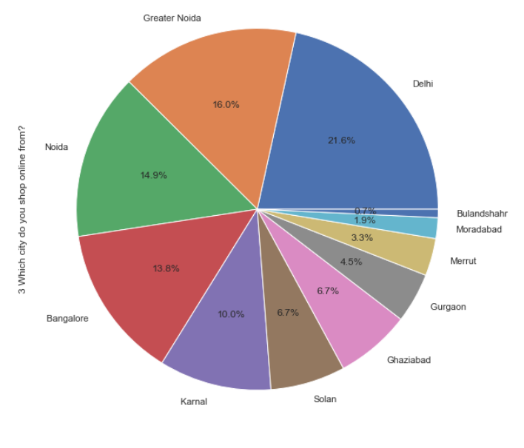
21.6% of online shoppers are from Delhi,
after Delhi, maximum shoppers are from Noida, Greater Noida, Bangalore

Slide 13
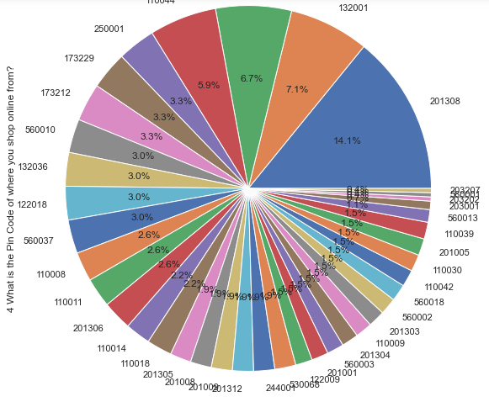
from the pie plot, we can observe that maximum online shoppers are from pincode 201308.
below the above pincode, majority shoppers are from 132001 and 201310.
the online retailers need to focus more on retention of the customers residing in these pincode

Slide 14
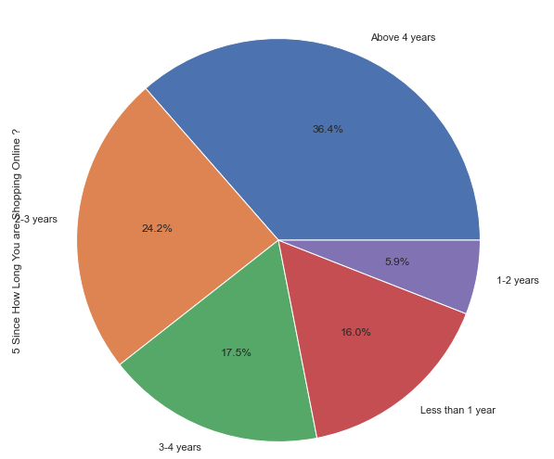
observation: more than 36.4% of the respondants are shopping online for more than 4 years,
24.2% of them for 2 to 3 years,
17.5 % for 3-4years,
5.9% for 1 to 2 years
16% of them for less than 1 year

Slide 15
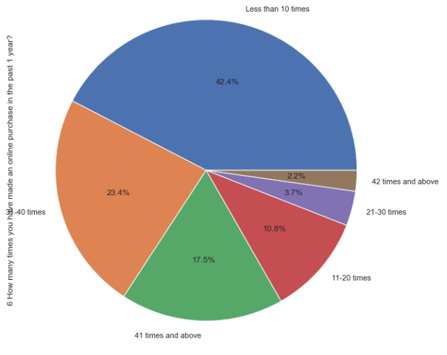
maximum of the respondants (42.4%) shop online for less than 10 times in a year
a small portion of respondants of nearly 2.2% shop online for more than 42 times

Slide 16
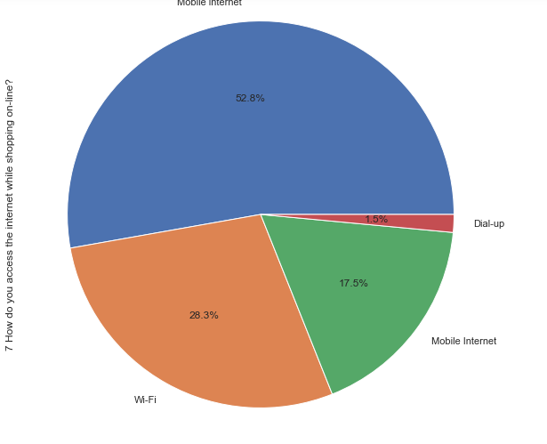
52.8% of the online shoppers use mobile data for online shopping
28.3 % uses wifi connection

Slide 17
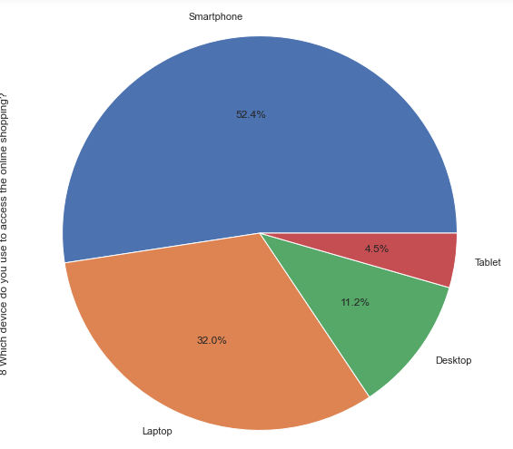
majority of the shoppers uses mobilephone (52.4%) for online shopping 32% uses laptop, 11.2 % uses desktop and 4.5% uses tablet
the companies need to focus on improvement and further development of their mobile applications

Slide 18
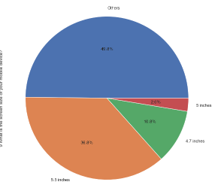
36.8% of the respondants uses mobiles of screen size 5.5 inches,
10.8% of the respondants uses mobiles of screen size 4.7 inches,
2.6% of the respondants uses mobiles of screen size 5 inches,
however, majority uses mobile devices of other display size, it can be abbreviated that the users uses devices of screen size greater than 5.5 inches because in the market majority of smartphones have size greater than 5.5 inches

Slide 19
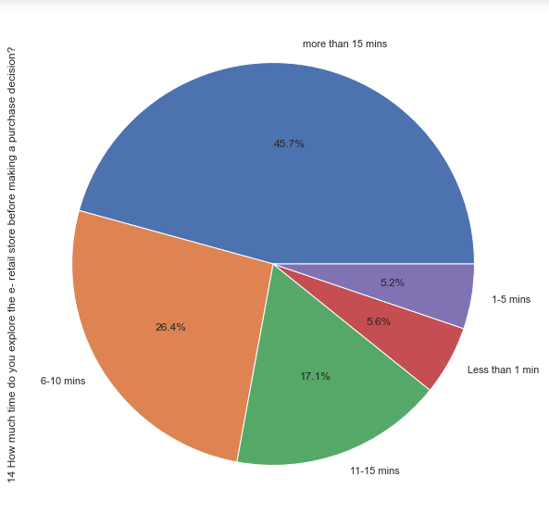
majority of the online shoppers explore the e-retail store for making their purchase decision, this means that they focus on product research and product comparison.

Slide 20
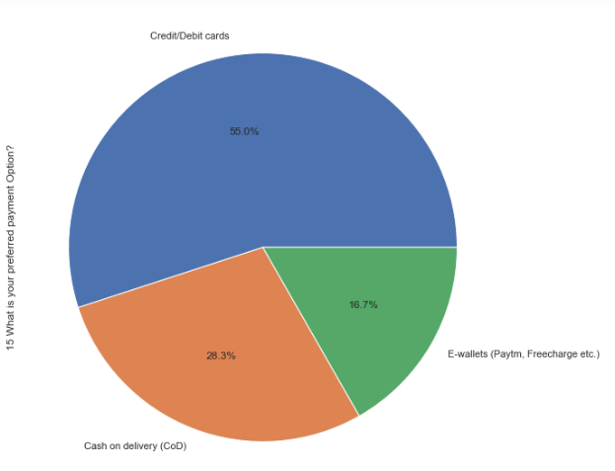
the most preferred payment option of the online shoppers is cerdit and debit cards. this suggets that the e-retail stores have established trust among the customers

Slide 21
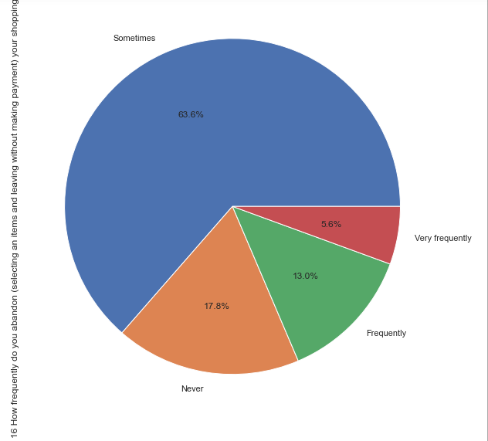
very few customers selects an item and nevers proceeds for payment
17.8% of the respondants always purchases as they adds product to cart
13% of respondants frequently leaves without purchasing

Slide 22
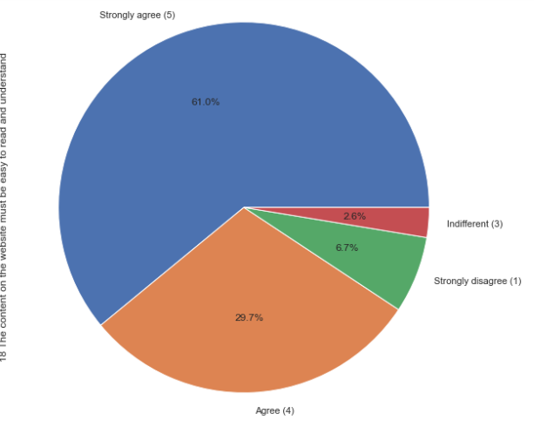
61% of the respondants strongly agree that the content must be easy for better understanding this means the online retailers need to focus on improvement of the interface to make it simple and clear for the users

Slide 23
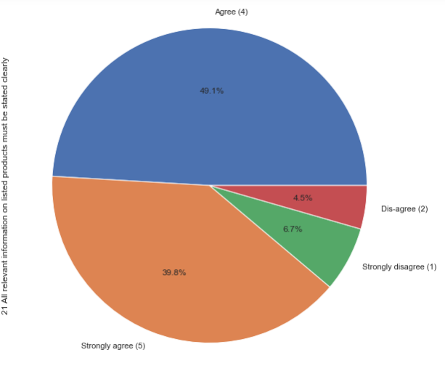
49.1% of the online shoppers agrees with this statement

Slide 24
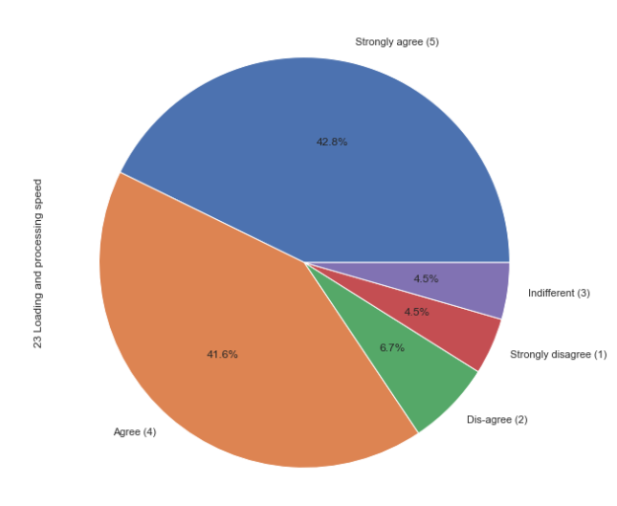
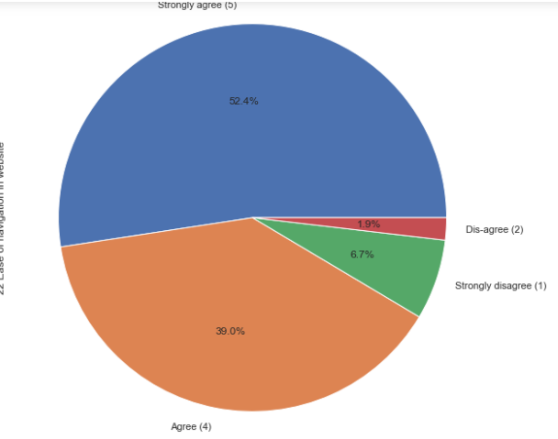

Slide 25
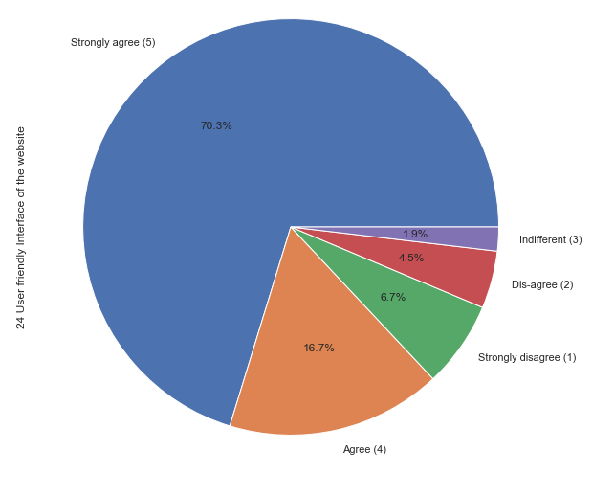
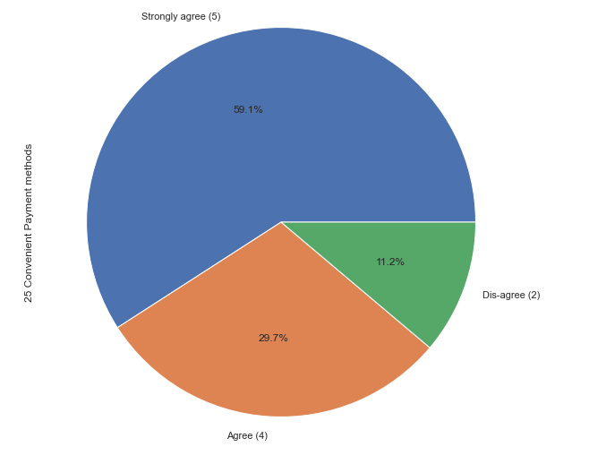

Slide 26
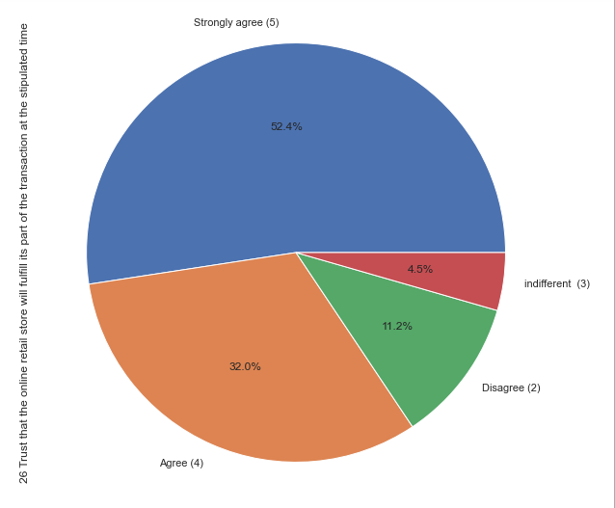
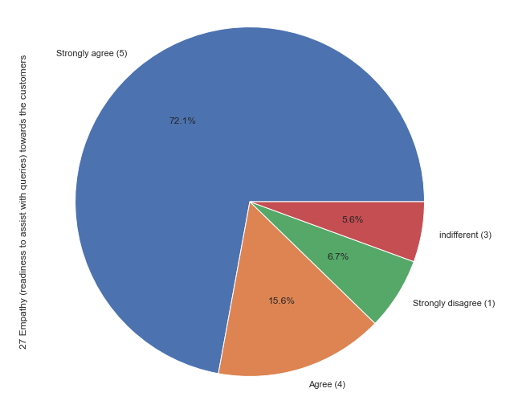

Slide 27
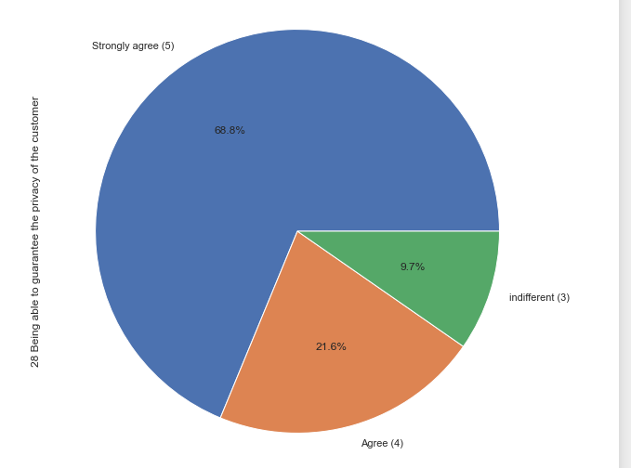
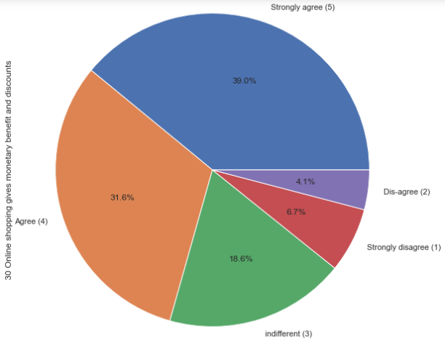

Slide 28
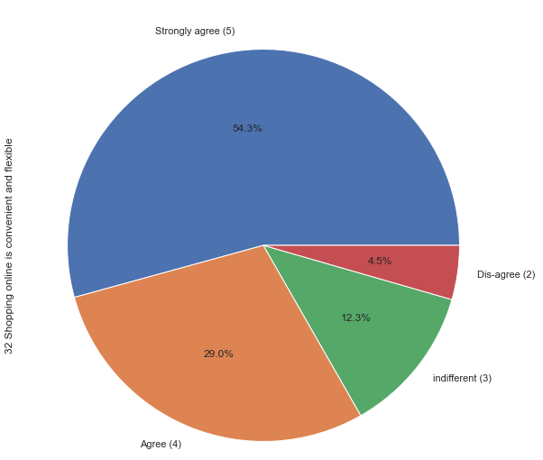
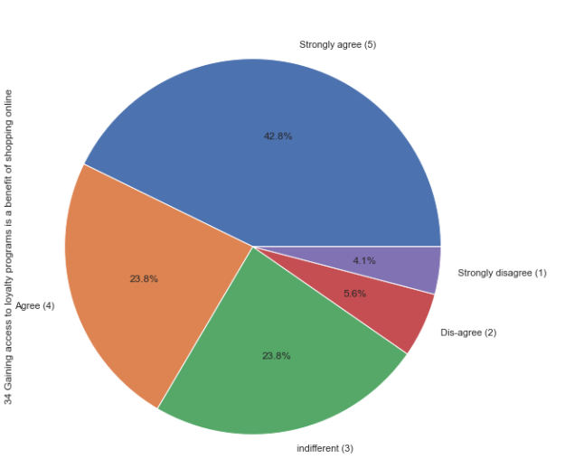

Slide 29
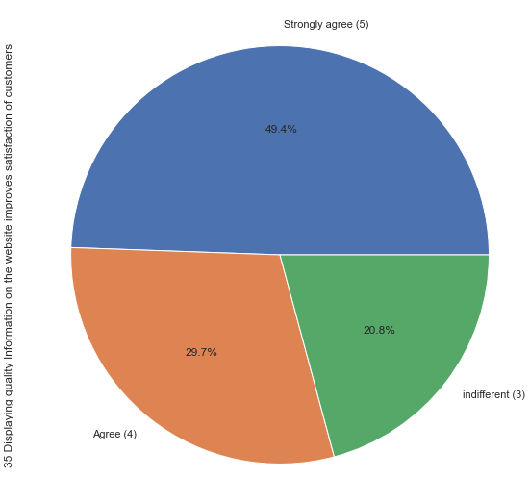
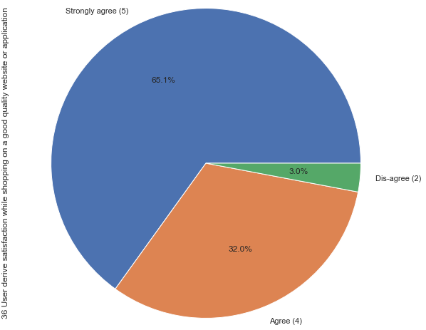

Slide 30
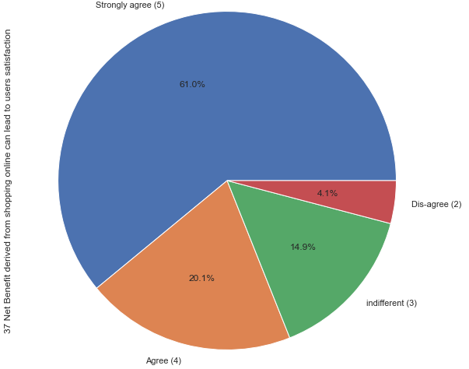
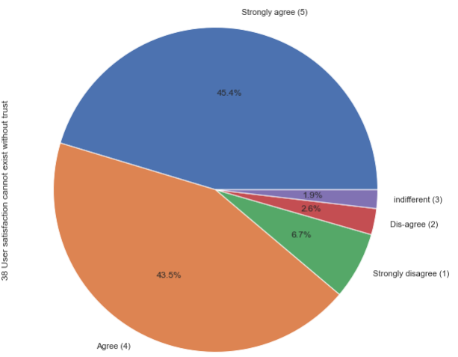

Slide 31
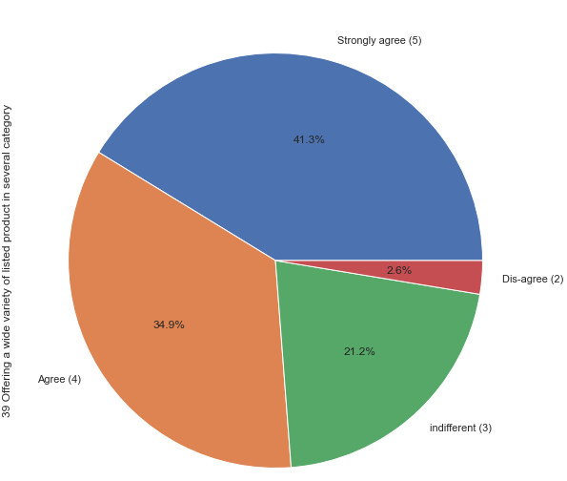
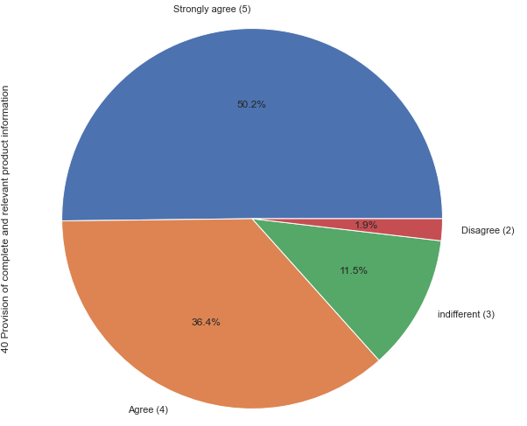

Slide 32
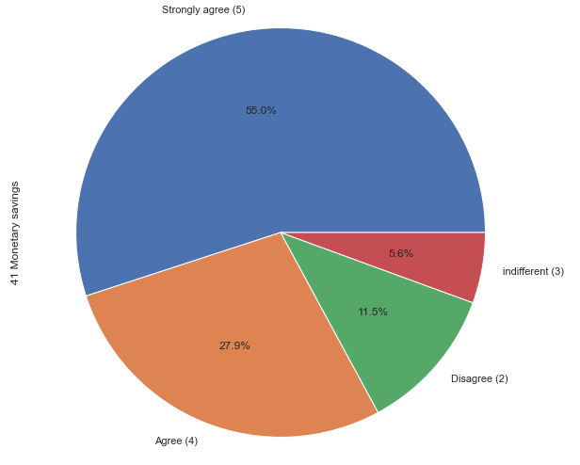
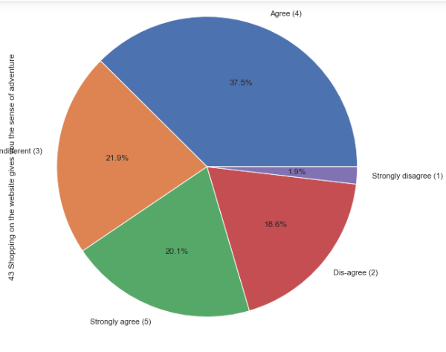

Slide 33
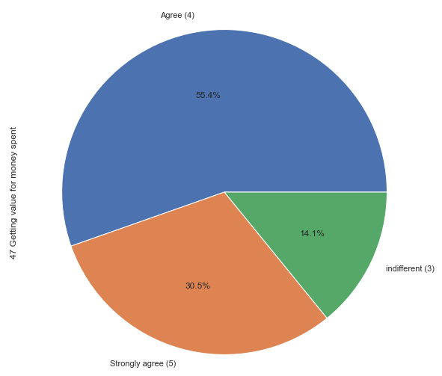

Slide 34
Insights
Majority of the shoppers strongly agrees on several aspects like ease of payment is important, information and description of the product, content of the website, information on seller details, ease of navigation, loading time of the website, convenience of payment, trust, securing the privacy of the customer, monetary benefits, loyalty programs, convenience and flexibility of shopping, and user satisfaction are all important for customer acquisition and retention in the online shopping industry in India.

Slide 35
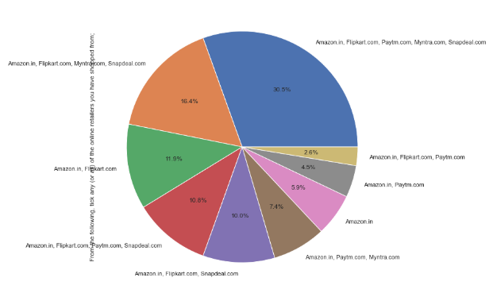
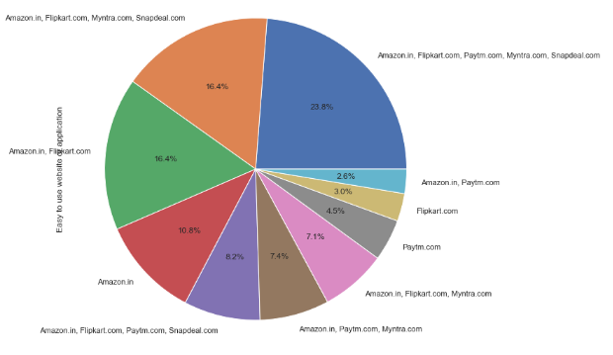
majority of people shops from all 5 retail stores and minority only shops from only amazon,flipkart and paytm and all of them suggests that all the 5 applications are easy to use

Slide 36
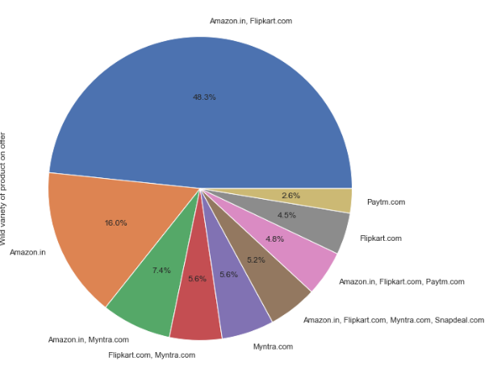
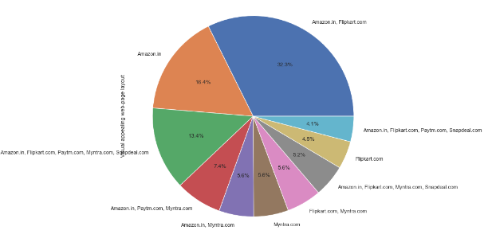
majority suggests that only flipkart and amazon have only visually appealing web layout, others need to work on it and only Flipkart and Amazon have a wide variety of products

Slide 37
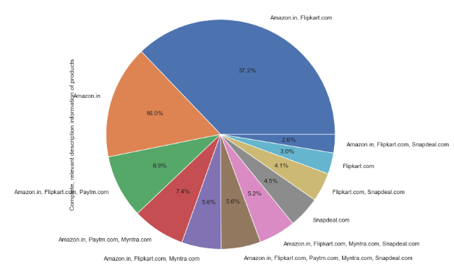
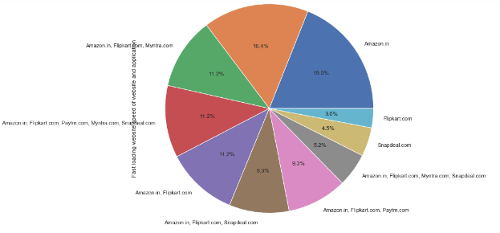
majority suggests that only amazon and flipkart have relevant product information and 19% suggets that only amazon has a fast loading website but more or less every application have fast loading website

Slide 38
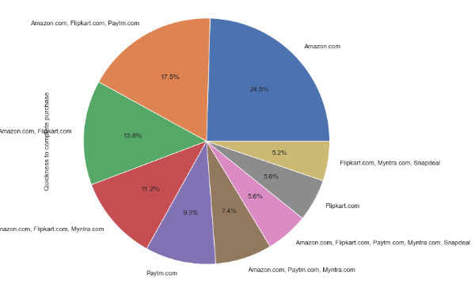
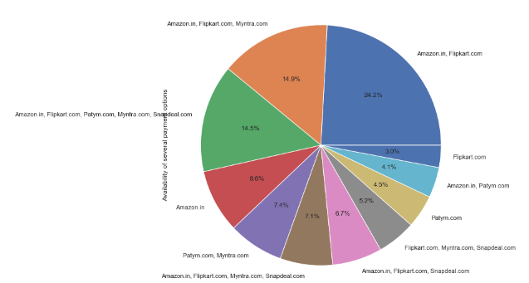
amazon is the most reliable website to online shoppers and majority suggests that amazon is the website where customers experience quick purchase

Slide 39
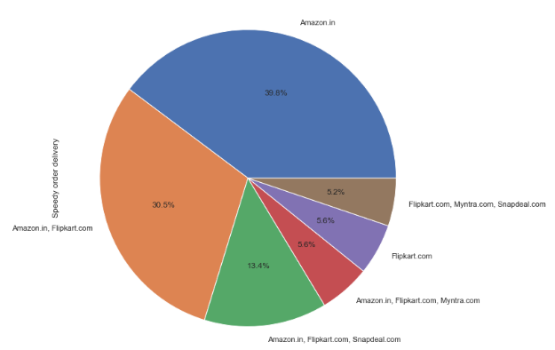
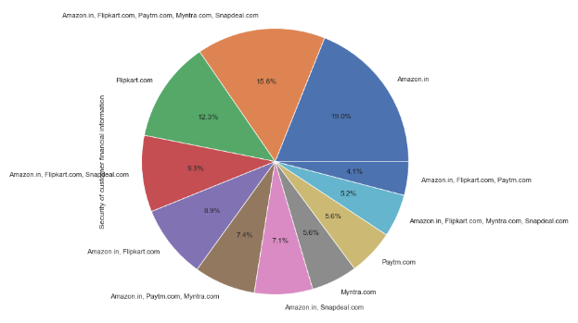
amazon and Flipkart have the mostly avaialable payment options and they are the most trusted online applications that secures customer's financial information

Slide 40
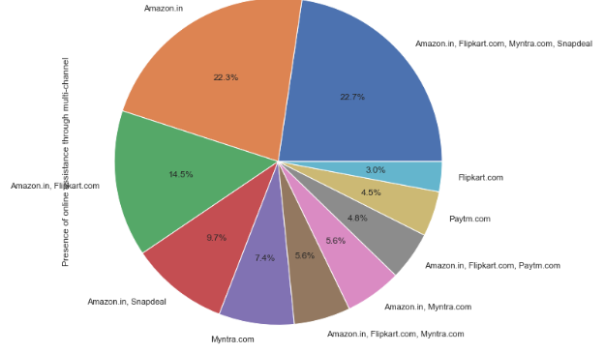
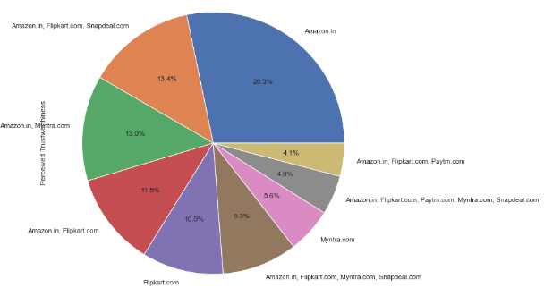
AMAZON is the most trusted online retail stores which got a vote of 28.3% amongst all and amazon, flipkart,snapdeal and myntra all have online assistance through multi-channel

Slide 41


amazon takes the longer time to log in during sales period. this means amazon has huge traffic during sales but both amazon and flipkart taken longer to display photos during sales period

Slide 42


myntra is perceived to take longer for declaration of price and it has the longest page loading time during sales

Slide 43


paytm has the longest delivery period and myntra has the fastest and amazon is the one that frequently changes application and website design. this means they focus on customer convenience

Slide 44


Both amazon and myntra has frequent page disruption but amazon has the most efficient website

Slide 45
Conclusion
it can be concluded from the graphs and the figures that the major players in the Indian online retail industry are Amazon, Flipkart, Myntra, Paytm and Snapdeal. Amazon and Flipkart are the top most players in the industry because they have successfully established customer trust by offering a wide product variety, range and benefits. Further, the customers are also satisfied with the ease of payment modes, convenience of delivery, product details and information. But they further need to focus on improvement of their websites and applications in order to reduce the loading time during the period of sales. Moreover, Flipkart and Amazon also needs to focus on faster delivery in order to remain competitive.

